Slide 1

Instructions
for making “POPRI” pitch

Slide 2
Presentation
Make your pitch simple and understandable
Be prepared, be yourself - use graphic material (photos, symbols, infographics) instead of text.
Do NOT use videos, animations or links.

Slide 3
Visual
materials
Use graphic material (photos, symbols, infographics) instead of text.
Do NOT use videos, animations or links.

Slide 4
Font
size
Choose a font that is easy to read.
The font size should not be smaller than 30.

Slide 5
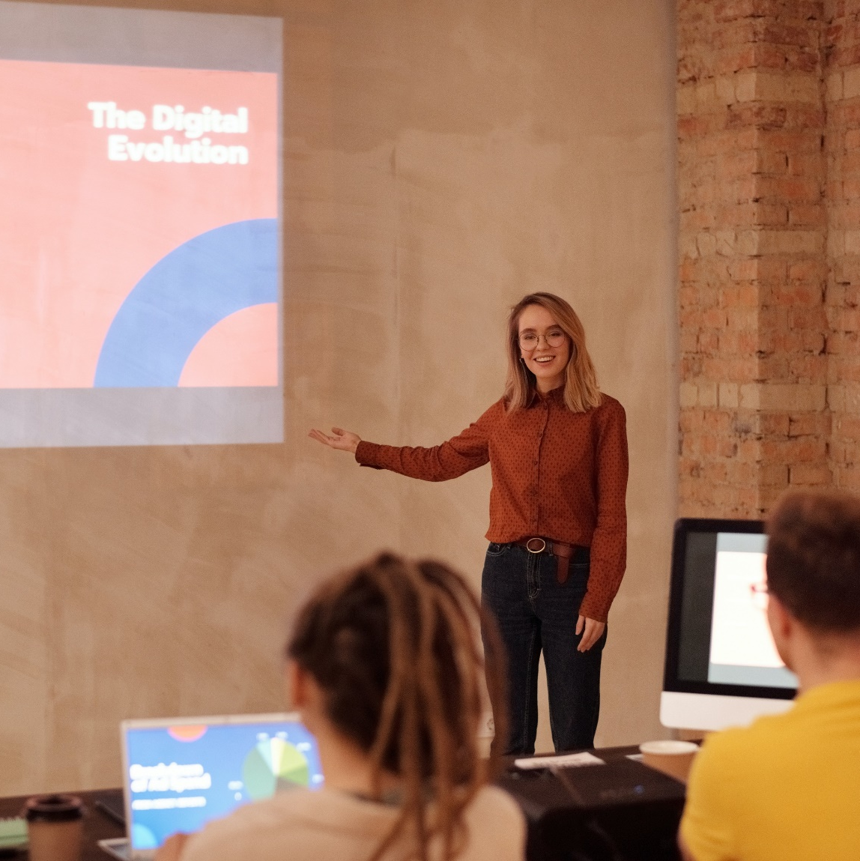
Clarity
1 idea per 1 slide.
The total number of slides ("main ideas") should be between 10 and 15.

Slide 6

Be concise
You have a total of 10 minutes:
5 minutes for your presentation, the remaining 5 minutes for answers to the jury's questions.

Slide 7
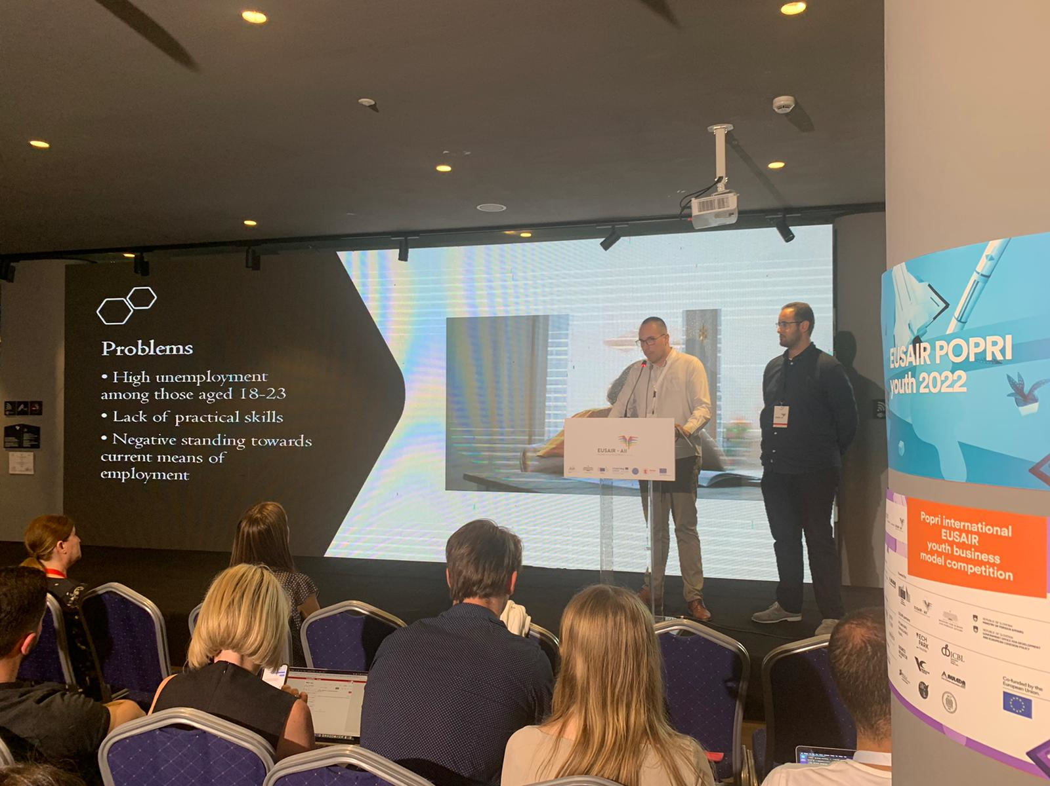
Will be held in English only
it takes place in front of the jury members and is open to interested listeners
5 minutes pitch - present your business idea clearly and concisely - the presentation will not be interrupted
5 minutes for questions from the jury members - impress them and be original in your presentation.
A ppt and a help screen are at your disposal
The course of the pitch

Slide 8

The evaluation
criteria
Part | Details | %
Business model/content |  | 67%
 | Coherence of business model segments
 | Business idea market potential
MVP (MINIMUM VIABLE PRODUCT) |  | 22%
 | Prototype or MVP (presentation value) Interaction with customers and other stakeholders
PRESENTATION | PERFORMANCE: clarity, sovereignty, commitment answers the jury's questions timing general impression | 11%

Slide 9

How you prepare a “POPRI” pitch ?
Watch the video

Slide 10
Introduction
Enter the name of the idea and /
or the slogan on the first page
Example:
My name is [first and last name]
and I will introduce you to [name of the idea] + 1 sentence description of the idea

Slide 11

Problem
Describe the problems
through the story (s)
of a typical customer.
Problems should be listed
and supported by evidence/statistics.

Slide 12
Solution/idea
Describe your solution (product or service).
Describe the main features of your solution
and how the individual features of the
solution solve the problems described earlier.
Show the operation of MVPs (prototypes).
Do not use videos or animations.

Slide 13
Concurence
Describe how customers solve problems today.
Have they found the easy solution?
What are the characteristics of competing products or services and how is your product
or service better than the competition‘s?

Slide 14

Entry to the market
Describe sales and promotional channels according to your target customers.
Describe the characteristics
of the market and its size.

Slide 15
Costs / revenue
Describe how the price was set.
List your costs (at least for the 1st year).
Describe the business model – How did you make decisions?

Slide 16
Results
Describe what you have done so far. Have you made
a MVP (prototype)? Describe, how MVP works.
Describe the results of interviews with potential buyers.
List the information you learned from experts and other people you spoke to.
Describe key metrics.

Slide 17

Future
Describe what do you need to start a business.
What do you expect from the jury
(links, contacts, feedback, advice)?
What is the purpose of your presentation?

Slide 18

The team
Picture of team members
Describe your team
members and their
key skills.

Slide 19
Conclusion
State or repeat your slogan:
(And don't forget…. "Nike - Just Do It.!")
Thank the listeners and invite members of
the jury to ask questions.
Write your contact (email, phone, website) on the slides.

